Slide 1
Lab 0: Intro to Arduino
Sean Prokop
ECE 5
Winter 2019

Slide 2
Objective
The objective of this lab is to get an introduction to simple Arduino code and breadboarding and circuit building basics.

Slide 3
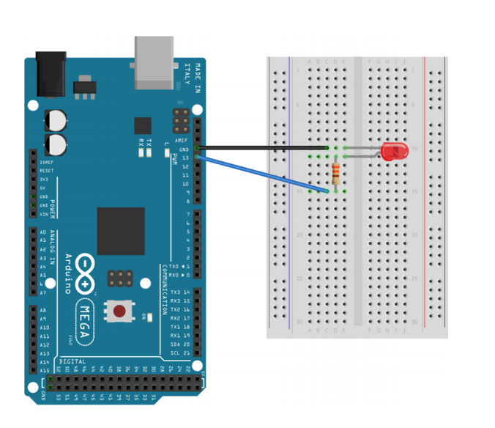
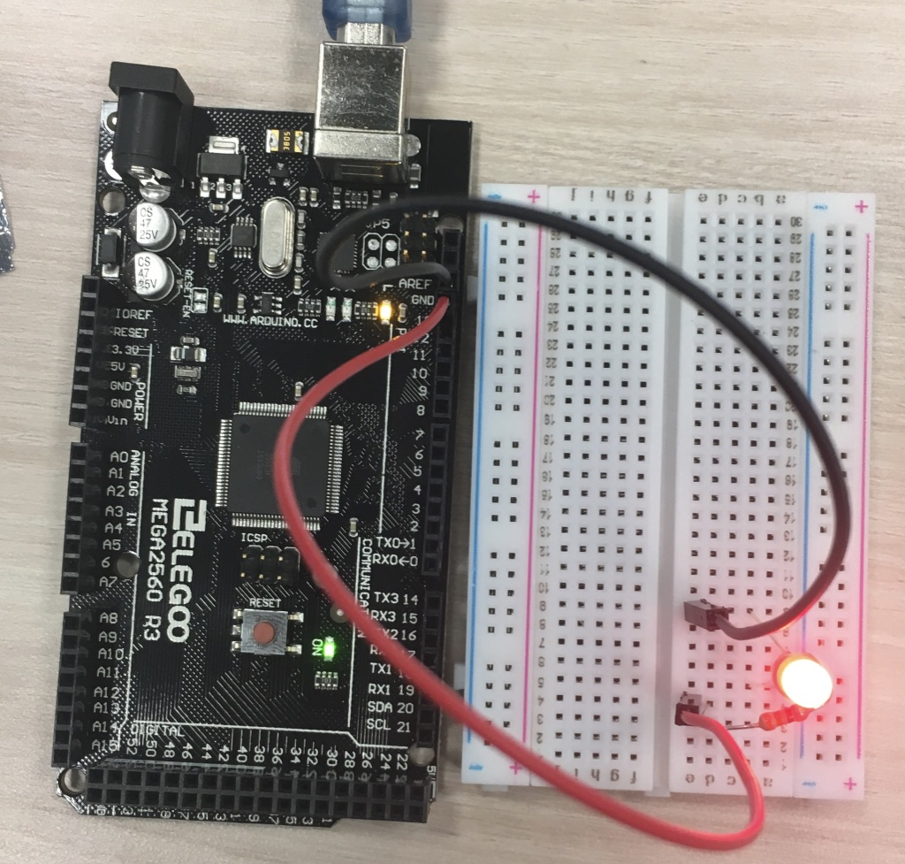
Challenge #1: Blinking LED
Circuit
Code
int led = 13;
void setup() {
pinMode(led, OUTPUT);
}
void loop() {
digitalWrite(led, HIGH);
delay(2000);
digitalWrite(led, LOW);
delay(1000);
}
This challenge is to use the Arduino to turn on the LED for 2s and turn it off for 1s. The circuit is simply a 330Ω in series with an LED, with power and return to the Arduino.

Slide 4
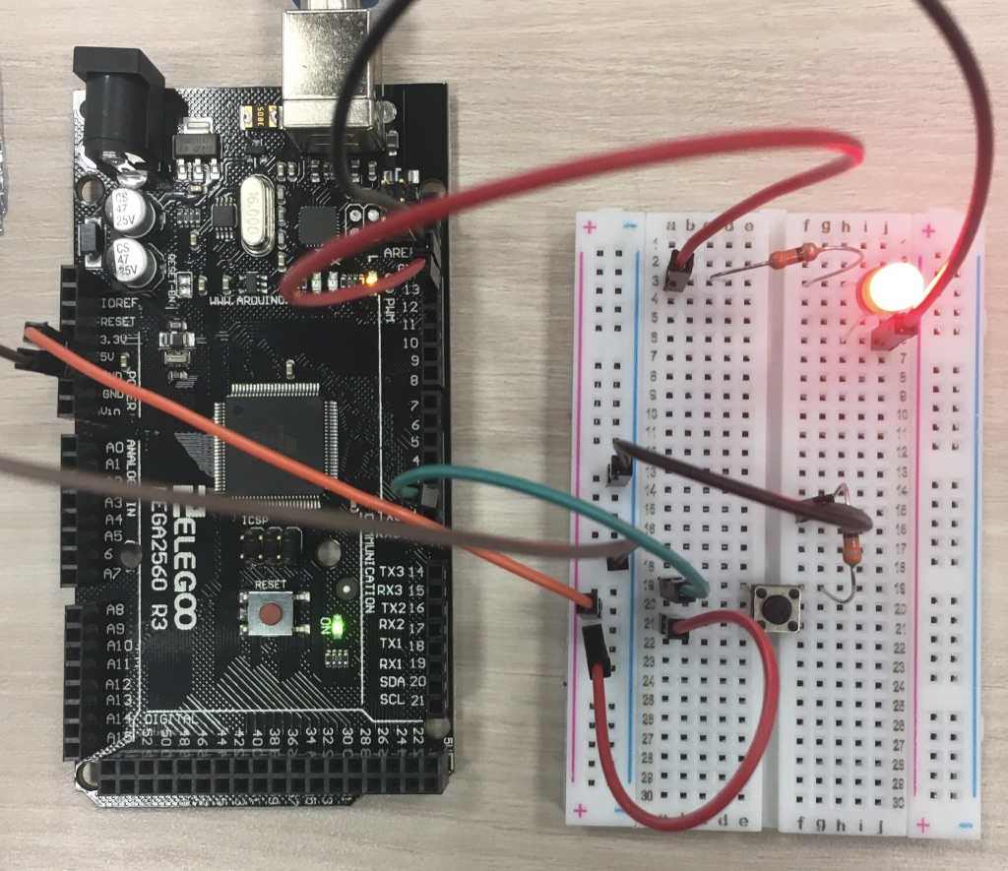
Challenge #2: LED and Button
Circuit
Code
int buttonPin = 2;
int ledPin = 13;
int buttonState;
int ledState = LOW;
void setup() {
// put your setup code here, to run once:
pinMode(buttonPin, INPUT);
pinMode(ledPin, OUTPUT);
}
void loop() {
// put your main code here, to run repeatedly:
buttonState=digitalRead(buttonPin);
if(buttonState==HIGH && ledState==LOW){
digitalWrite(ledPin, HIGH);
ledState = HIGH;
}
else if(buttonState == HIGH && ledState==HIGH){
digitalWrite(ledPin,LOW);
ledState=LOW;
}
delay(100);
}
This challenge is to use a button to switch the state of an LED. The button circuit has a connection to 5V, GND (through a 330Ω resistor), and a wire to a pin on the Arduino to give the signal.

Slide 5
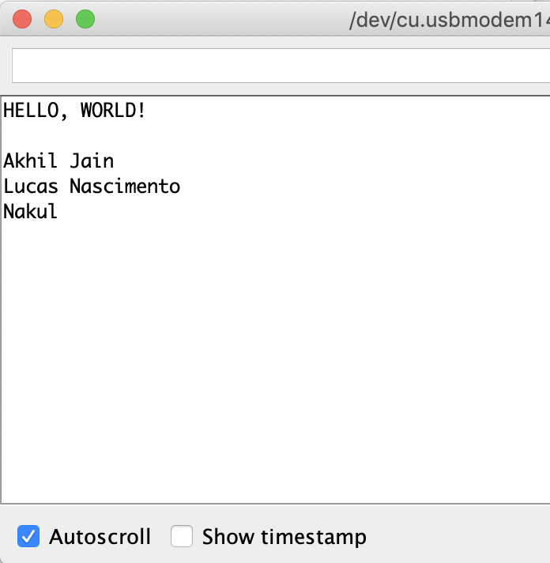
Challenge #3: Serial Monitor
Code
Serial Monitor
void setup() {
Serial.begin(9600);
Serial.print("HELLO, WORLD!");
Serial.print("\n\n");
Serial.print("Akhil Jain\n");
Serial.print("Lucas Nascimento\n");
Serial.print("Nakul\n\n");
}
void loop() {
}
I simply printed Hello World followed by two \n’s, and then three neighbors’ names followed by \n.

Slide 6
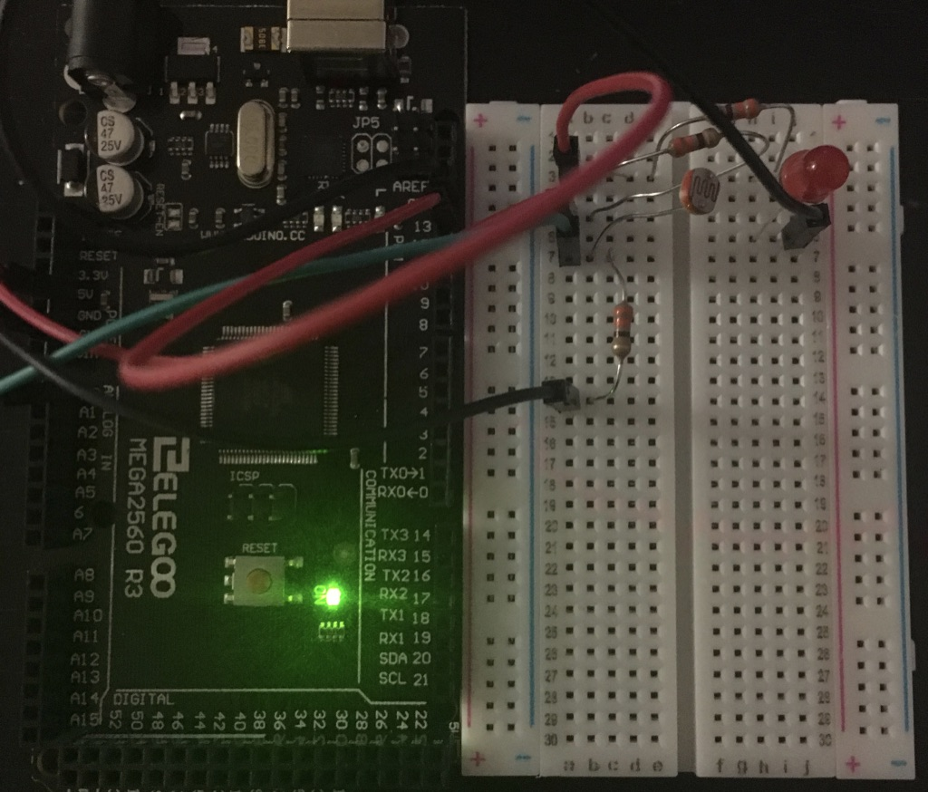
Challenge #4: Photoresistors
Circuit
Code
const int sensorPin = A0;
int led=13;
int lightLevel;
void setup() {Serial.begin(9600);
pinMode(led,OUTPUT);
pinMode(sensorPin,INPUT);
}
void loop() {
digitalWrite(led,HIGH);
delay(2000);
lightLevel=analogRead(sensorPin);
digitalWrite(led,LOW);
Serial.print("The photoresistor is reading: ");
Serial.println(lightLevel);
delay(1000);
lightLevel=analogRead(sensorPin);
Serial.print("The photoresistor is reading: ");
Serial.println(lightLevel);
}
The code turns on the LED for 2s, reads the light, and then turns it off, prints the light level, and reads and prints again. The figure shows the LED circuit (I used parallel resistors to play around with the brightness) and the photoresistor voltage divider.

Slide 7
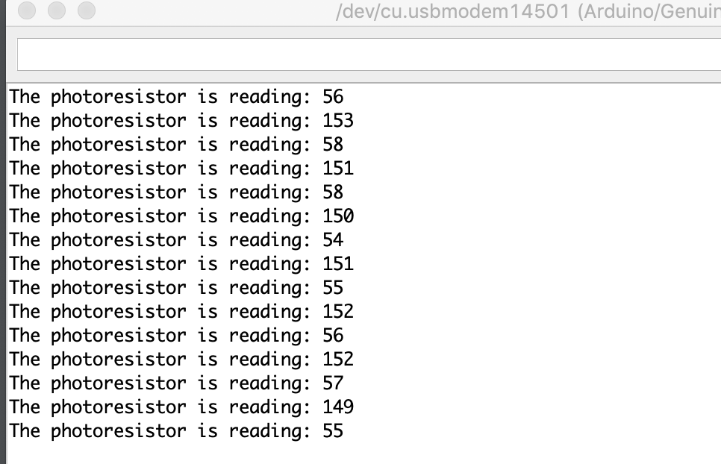
Challenge #4: Photoresistors
Circuit
Serial Monitor
The output shows the light level reading when the LED is on, and also the reading when the LED is off.

Slide 8
Experience
The most valuable part of the lab for me was just getting to play around with an Arduino because that’s always fun.
As a senior, I feel like some of the stuff isn’t explained very well for a completely new freshman taking ECE 5. Challenge 4 for example has a voltage divider using a photoresistor, but doesn’t at all explain what is going on because someone completely new wouldn’t know what a voltage divider is. Also, the lab instructions don’t make it very clear as to what you are supposed to accomplish. It has a lot of other information but only very briefly explains what you want the circuit and code to do and doesn’t make it easy to find.

Slide 9
Submission
Submit the following through TritonEd submission portal.
Completed Slides as a PDF document
All .ino code files you created/edited compressed in 1 zip folder
Each file should have your name included (ie SmithJohn_Lab0.pdf or SmithJohn_Lab0ch1.ino)
Take at least 2 minutes to make your slides clean / presentable

